Slide 1
Matrix-vector operations
By Hurles

Slide 2
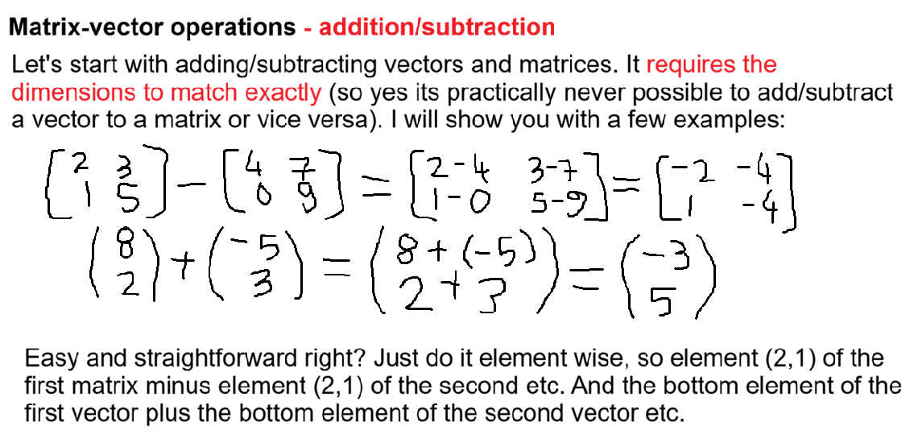

Slide 3
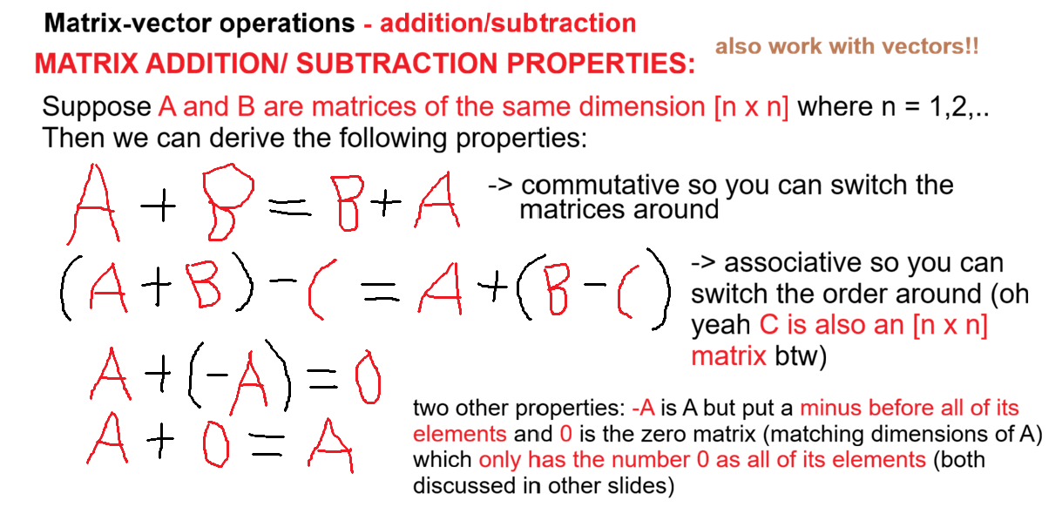

Slide 4
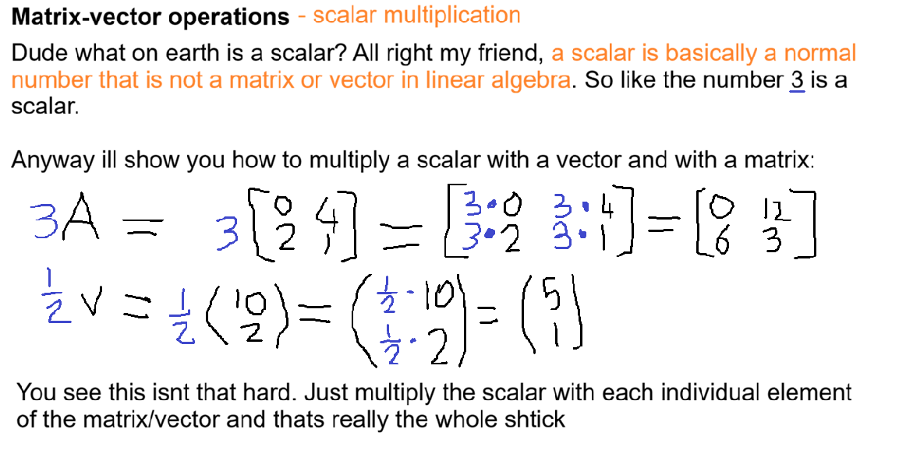

Slide 5
